Slide 1

Design and Implementation of Efficient AI Accelerator for Drone Vision System UNDER THE GUIDANCE OF PROF. DR. ANAND D. DARJI Presented by Krish Patel (U22EC013) Dhairya Pandit (U22EC017) Aditya Chandel (U22EC070) B.Tech. 4th Year DoECE, SVNIT 4th Dec 2025 | 9:30AM | EC406N, DoECE

Slide 2
Motivation
Need for real-time obstacle avoidance in drones
GPS failures indoors → requires vision-based navigation
Deep learning is heavy for microcontrollers
LiDAR/stereo are costly & bulky
Demand for low-power, fast, on-device AI for UAVs

Slide 3
Problem Statement
Drones require accurate, real-time depth estimation for safe navigation.
Existing CNN-based depth models are too slow and power-hungry for embedded hardware.
Traditional sensors (LiDAR/stereo) are heavy, expensive, and unsuitable for small UAVs.
Need a lightweight, hardware-accelerated solution for depth estimation and path planning on resource-constrained platforms.

Slide 4
Objectives
Design depth estimation system
Develop custom FPGA convolution accelerator
Implement hardware path planning module
Explore STM32N6 NPU deployment
Evaluate accuracy, power, and resource usage

Slide 5
System Overview
A monocular depth estimation model predicts scene depth from a single RGB image.
A custom FPGA-based convolution accelerator performs fast spatial filtering using Q8.8 fixed-point arithmetic.
A hardware path planning module converts the depth map into a safe yaw angle for navigation.
The system is designed for low-latency, low-power operation on embedded UAV platforms.
STM32N6 NPU used for optimized model deployment with quantization-aware training.

Slide 6
Depth Estimation Overview
Predicts relative depth from a single RGB image
Used for obstacle detection and safe UAV navigation
More compact and cheaper than LiDAR or stereo systems
Uses a lightweight encoder–decoder network optimized for embedded devices
Produces a depth map that feeds the path-planning module

Slide 7
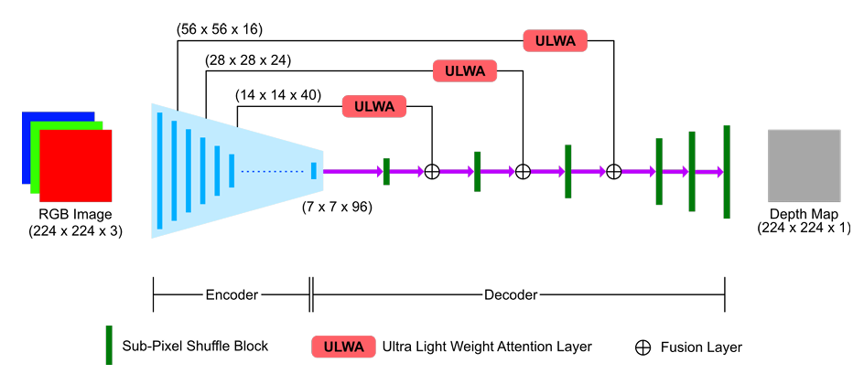
Model Architecture
Built using a compact Encoder–Decoder framework
Encoder: MobileNetV3-Small
Inverted residual blocks
Squeeze-and-Excitation (SE)
Hard-Swish activation
Extracts multi-scale features efficiently
Decoder: ULWA (attention-based)
Channel + spatial attention to refine features
PixelShuffle for lightweight upsampling
Produces a dense depth map suitable for real-time UAV navigation

Slide 8
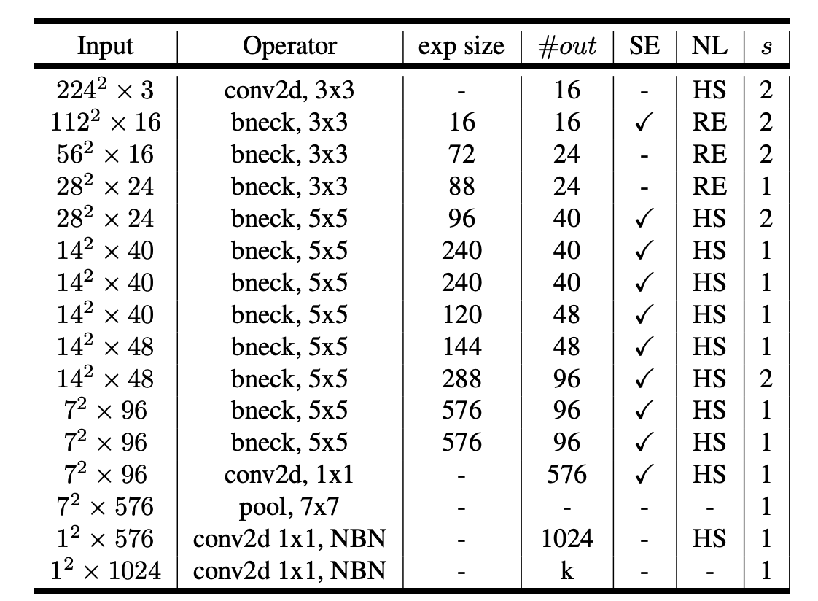
Encoder (MobileNetV3-Small)
Designed for low-power and fast inference
Uses Inverted Residual Blocks for efficient feature extraction
Includes Squeeze-and-Excitation (SE) units for channel attention
Uses Hard-Swish activation to reduce computation cost
Extracts multi-scale spatial features needed for depth estimation
Lightweight backbone ideal for embedded and FPGA/NPU deployment

Slide 9
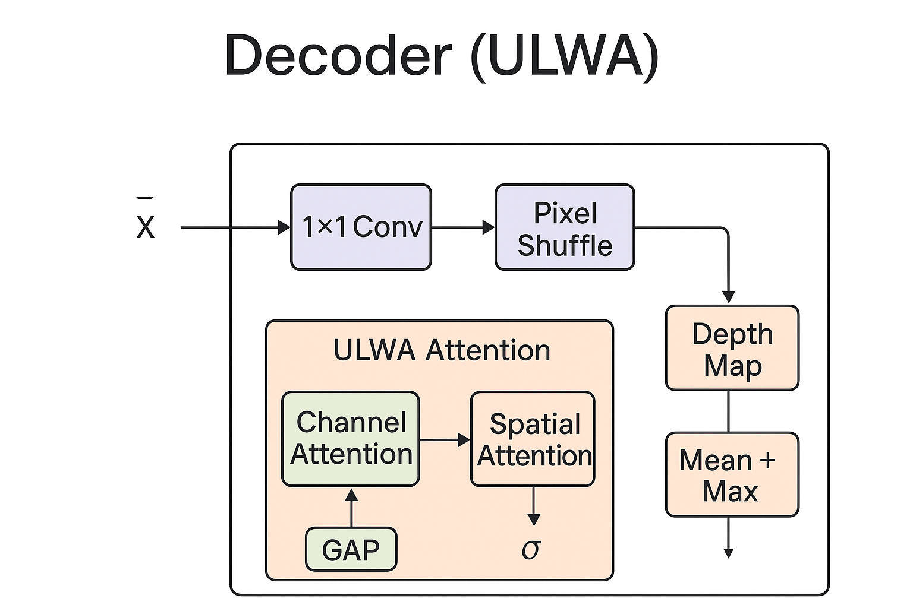
Decoder (ULWA)
Reconstructs full-resolution depth maps through progressive upsampling
Uses PixelShuffle (1×1 conv → channel expansion → spatial rearrangement)
More efficient than transposed convolutions
Includes ULWA attention for improved depth quality
Channel Attention:
GAP → MLP → Sigmoid
Emphasizes important feature channels
Spatial Attention:
Mean + Max maps → 7×7 conv → Sigmoid
Highlights key spatial regions
Output depth maps show better sharpness, continuity, and texture consistency

Slide 10
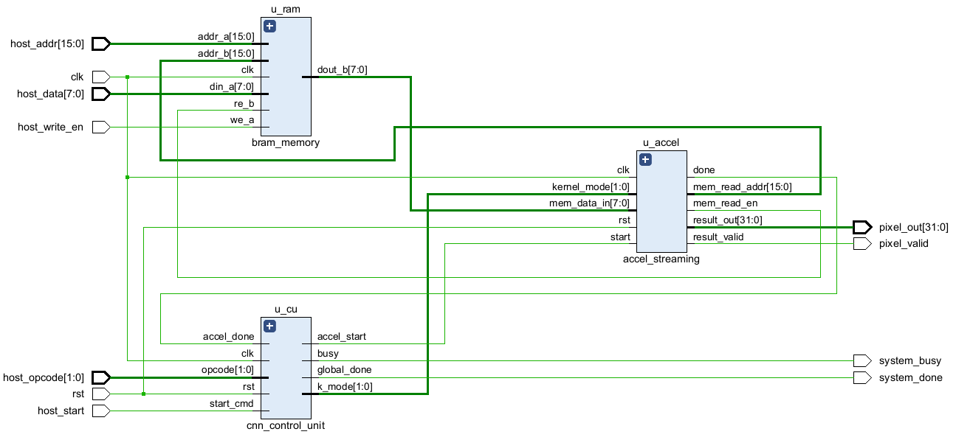
Hardware-Friendly Convolution Design
Custom FPGA-based convolution accelerator for depth-estimation filters
Supports 1×1, 3×3, 5×5, 7×7 kernels
Uses a sliding-window + line-buffer architecture for efficient data reuse
Implements Q8.8 fixed-point arithmetic to reduce power and memory
Parallel MAC array for low-latency spatial filtering
Designed to run in real time on resource-constrained UAV hardware

Slide 11
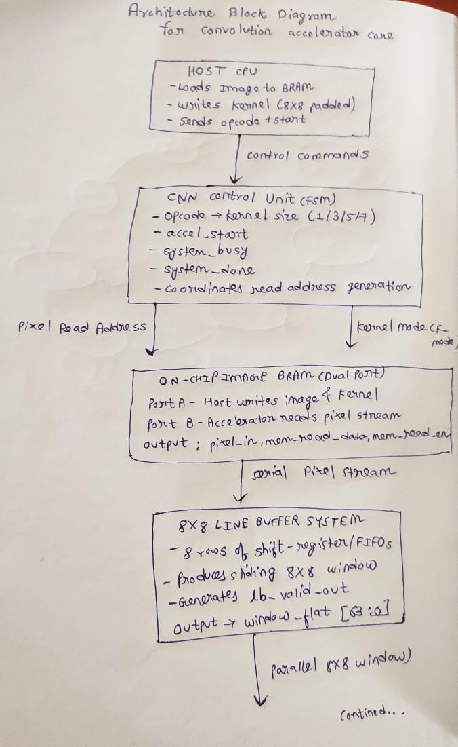
​Convolution Accelerator Architecture

Slide 12
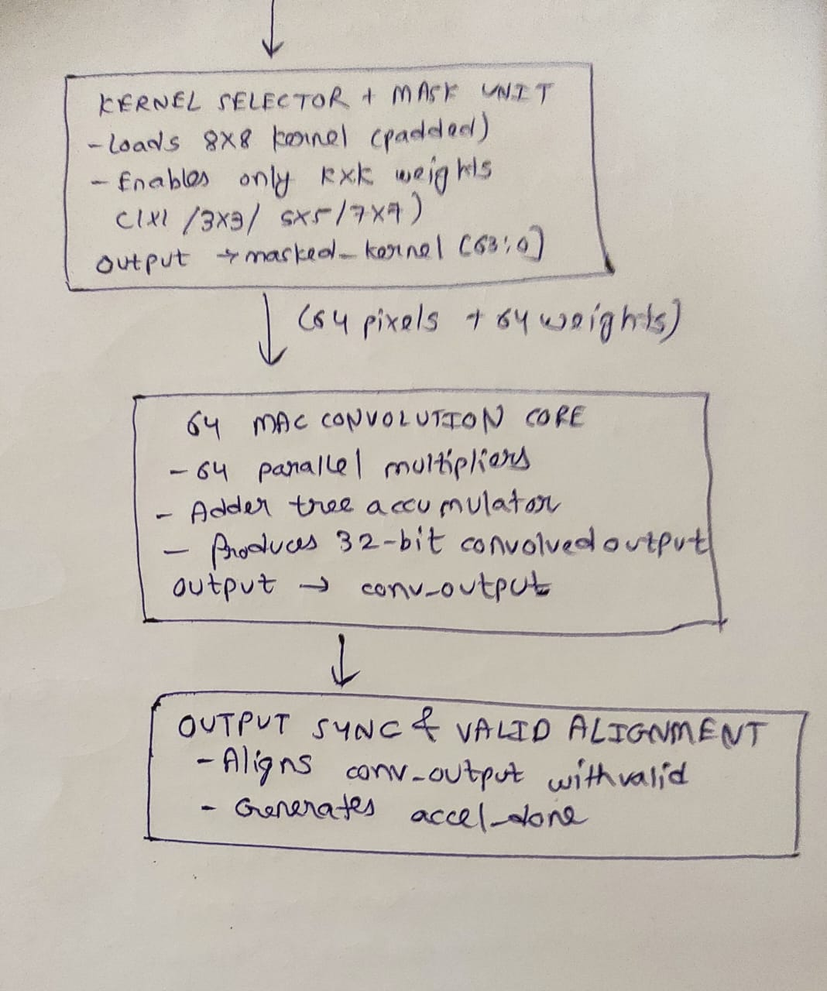

Slide 13
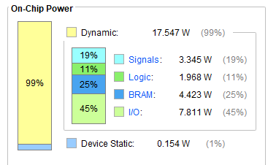
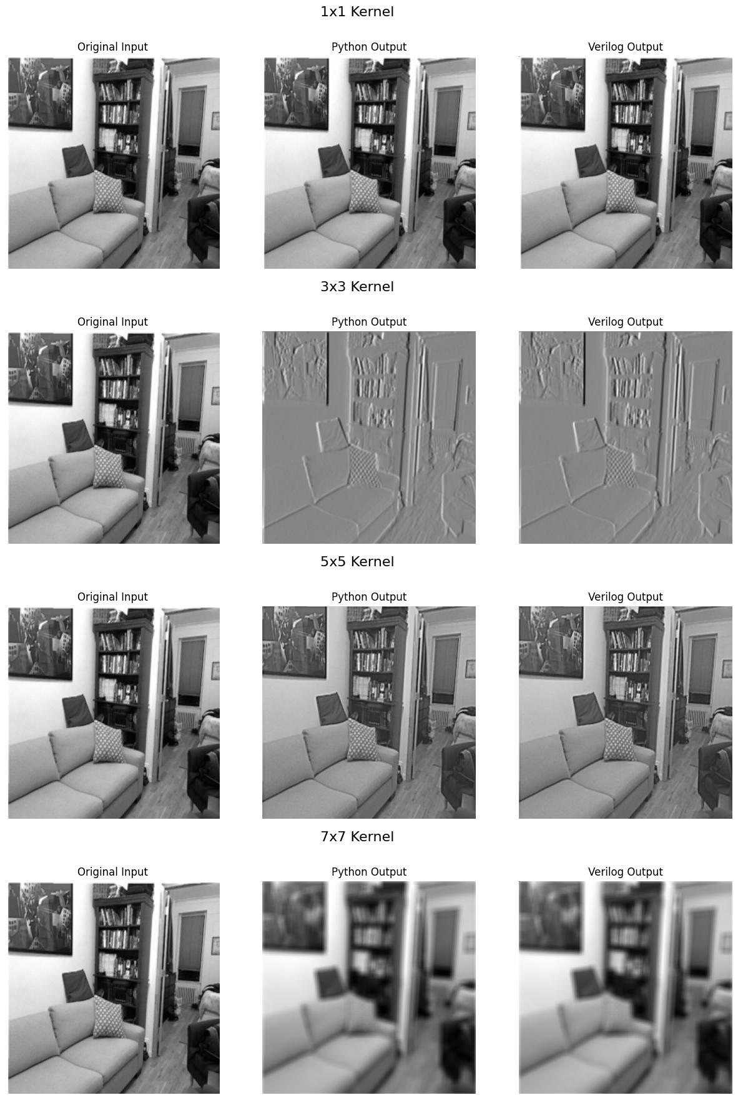
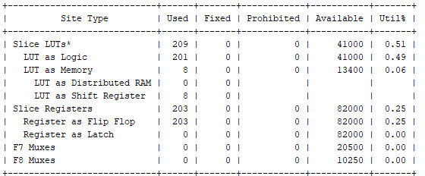
Results
Pixel-Level Accuracy: 0.00213 mismatch vs Python reference (bit-accurate).
Ultra-Low Resource Usage: 209 LUTs, 203 registers (<1% FPGA) for multi-instance support.
Supported Kernels: 1×1, 3×3, 5×5, 7×7 via unified 8×8 fixed-function MAC.
Real-Time Throughput: 1 pixel/cycle after 735-cycle warm-up with line-buffer sliding window.
Fixed-Point Precision: Q8.8, 217×217 output with deterministic latency.
Power-Efficient: Dynamic power-dominated, ideal for UAVs and robots.

Slide 14
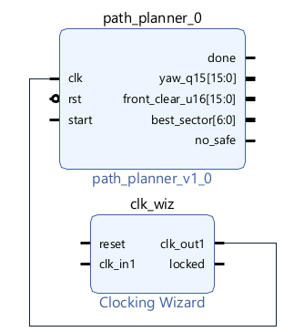
Path Planning Overview
Drone navigation requires safe, real-time obstacle avoidance.
Our system uses monocular depth estimation + hardware path planner.
The path planner is implemented as a Seven-State Finite State Machine (FSM).
The module consists of 3 inputs(clk, rst and start signals) and 5 outputs(done : To check whether minimum depth is found, yaw angle, clearance, best sector and a emergency flag: : To check whether path is safe or not.)

Slide 15
Why Depth-Based Field of View (FOV) Method?
Depth map gives relative distance of obstacles from a single RGB frame.
FOV is divided into angular sectors, each representing a possible direction.
Depth-based FOV is chosen because it:
Lightweight → no heavy optimization or search.
Works in real time on embedded hardware.
Only needs simple comparisons → perfect for FPGA.
Ideal for micro-drones where computation/power must be minimal.

Slide 16
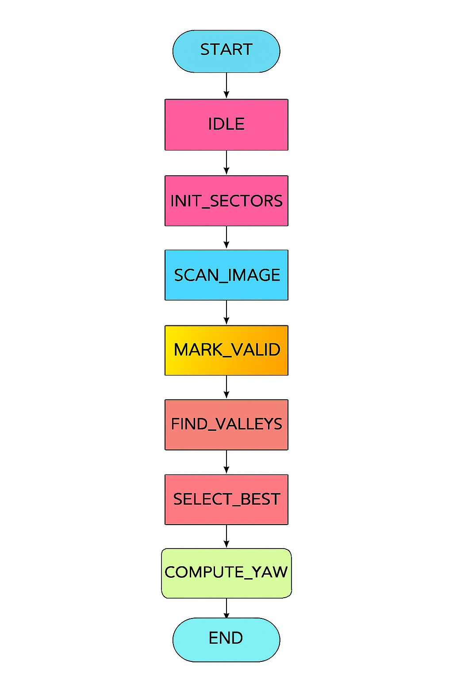
Seven-State Path Planning Flowchart and FSM
State 1: IDLE
The FSM waits for the start signal.
All internal counters, thresholds, and registers hold their previous values.
Ensures stable initialization and avoids unintended transitions.
As soon as start = 1, FSM moves to the next state.
State 2: INIT_SECTORS
Divides the drone’s Field of View (FOV) into multiple angular sectors.
Clears previous depth values for all sectors.
Initializes sector index = 0.
Prepares memory buffers to store the minimum depth per sector.
Ensures a clean start for every frame of depth input.

Slide 17
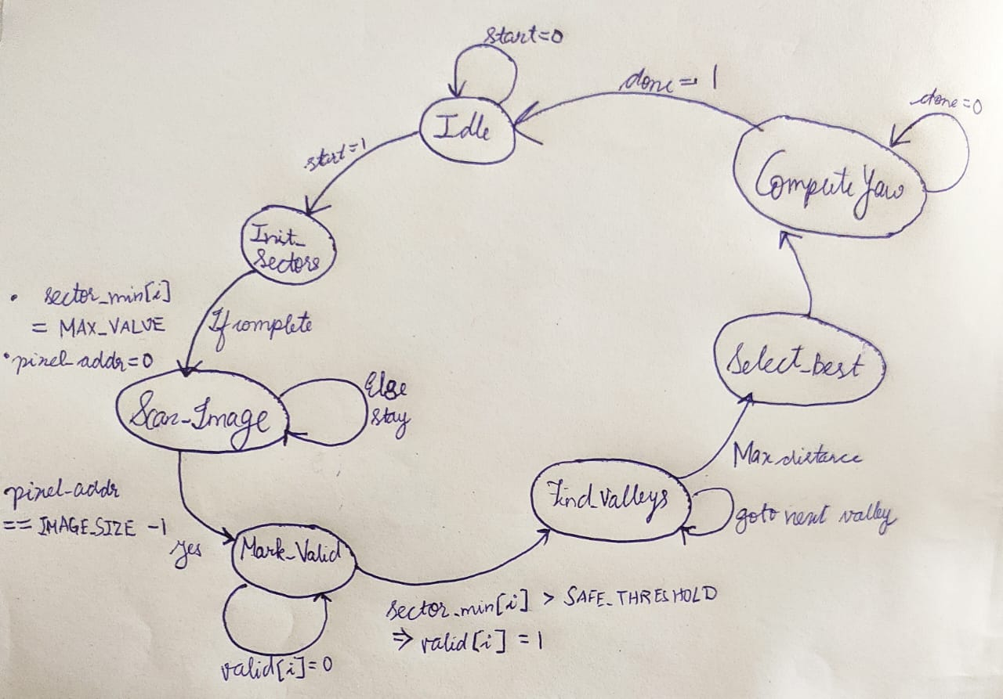
FSM

Slide 18
State-by-State Explanation
State 3: SCAN_IMAGE
Reads the depth map pixel-by-pixel and row-by-row.
Each pixel is assigned to its corresponding sector based on horizontal location.
Tracks the minimum depth (closest obstacle) inside each sector.
After the entire image is scanned, each sector has a representative depth value.
State 4: MARK_VALID
Compares each sector’s depth value with a safety threshold.
Marks sectors as:
VALID → safe to move
INVALID → obstacle too close
This step filters out sectors that are unsafe due to nearby obstacles.
If no sector is valid, a no_safe flag is raised for emergency behavior.
State 5: FIND_VALLEYS
Searches for continuous valid sectors, called “valleys”.
A valley represents a contiguous open space wide enough for flight.
Identifies candidate safe regions in the environment.

Slide 19
Remaining States
State 6: SELECT_BEST
Among all valleys, selects the best possible direction based on:
Maximum depth (largest clearance)
Widest valley (more maneuvering space)
Drone’s forward direction preference
Outputs the best_sector index.
Ensures the drone heads toward the safest, most open direction.
State 7: COMPUTE_YAW
Converts the selected sector into an actual yaw angle.
Uses a fixed-point Q15 representation for hardware efficiency.
Provides a smooth, centered direction inside the chosen valley.
Passes yaw, best sector, and safety flags to the flight controller.
FSM then transitions to END, signaling completion.

Slide 20
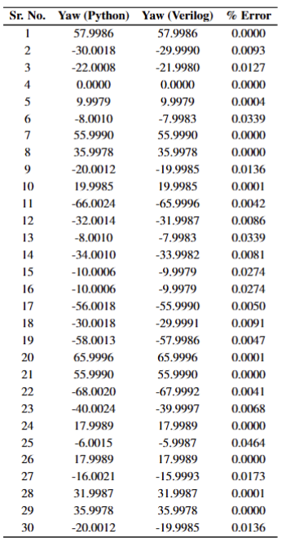
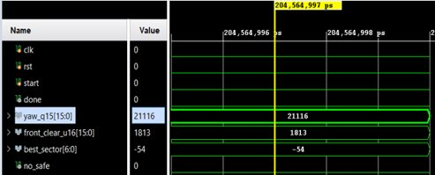
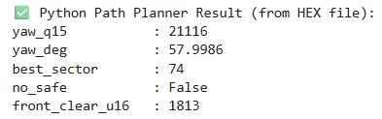
Results
Example1:​
Calculation1: 21116/32767 * 90 = 57.9986 because yaw angle is encoded between –1 to 1 using 15 bits and to scale it between –90 to 90 degrees, we divide by (2^15-1)=32767 and then multiply by 90 .

Slide 21
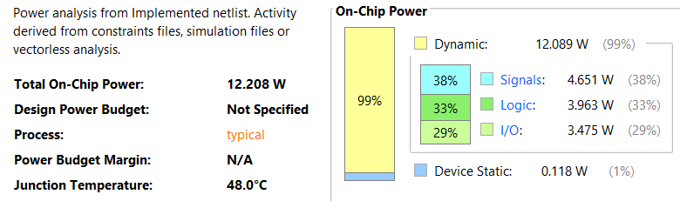
Results
Total power consumption is 12.2W.
The accuracy of the module is high as when it was tested for 30 different depth images , the error between Python and Verilog implementation is less than 0.05% consistently.

Slide 22
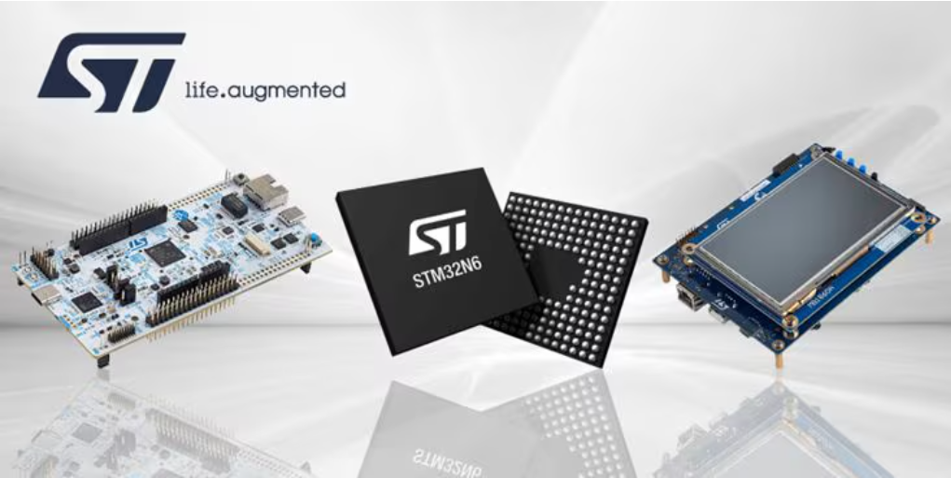
Closing the Gap Between MCUs and MPUs
The new class of crossover MCUs integrates
A high-performance Arm Cortex-M55
A dedicated Neural-ART Accelerator (1 GHz, 600 GOPS)
A modern Flash-less architecture with 4.2 MB SRAM
Advanced vision, audio, and graphics accelerators

Slide 23
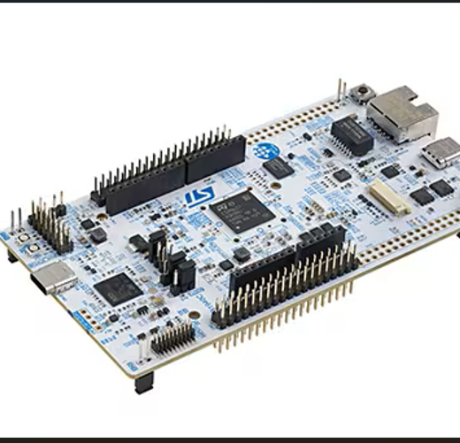
Hardware Specifications: NUCLEO-N657X0-Q
ARM-cortex-M55 running at 800 MHz with Helium Vector Extensions
Integrated Ethernet, USB type C, & MIPI/ Parallel camera interfaces
High speed OctoSPI for connecting external flash & RAM

Slide 24
Why NPUs for Drone Vision System?
Neural Art Accelerator functions as a systolic array, executing roughly 300 MACs per clock cycle.
Massive parallel MAC operations required by CNNs.
Approximately 600x the inference performance then H7 micro-controllers.
Hard-wired logic consumes less power .
Approx power consumption 1 TOPS.

Slide 25
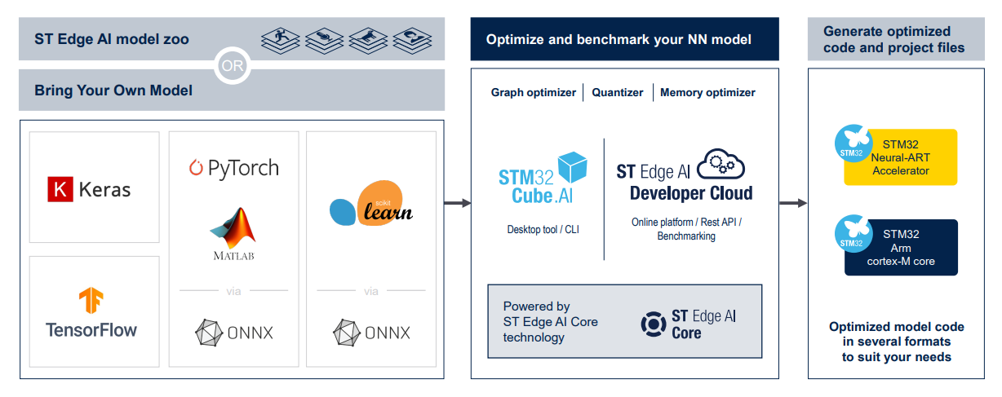
AI Model Implementation on NPU Board

Slide 26
X-CUBE-AI & Model Processing
Graph Analysis
Validates that all layers used in the model are supported by the Neural-ART accelerator or mapped efficiently to the Cortex-M55
Operator Fusion
Combines sequences such as Conv + BatchNorm + ReLU to reduce intermediate memory transfers and improve latency
Memory Allocation
Places large model weights in external Flash (XSPI) while keeping activation buffers in high-speed AXI-SRAM for maximum throughput

Slide 27
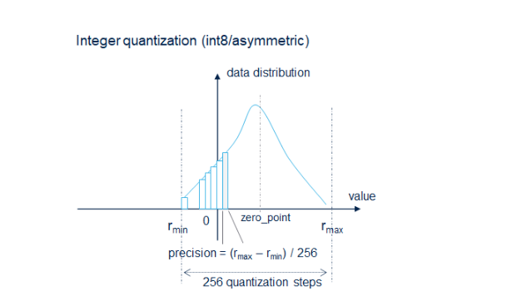
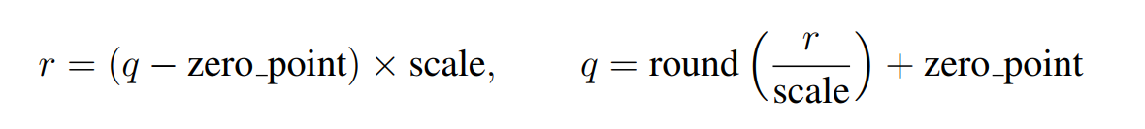
Post Training Quantization (PTQ)
NPU works only on INT8 operations, & the CPU operates the FP32 data.
Creates a huge mismatch in accuracy & also affects the latency.
Therefore, the Model is forced to PTQ, and the FP32 data-trained model is quantized to perform on INT8 data.

Slide 28
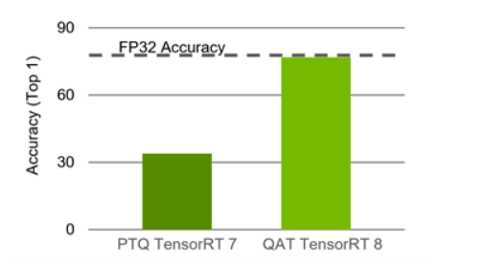
Solution: Quantize-Aware-Training
Simulation of the Quantization Noise during training.
Model learns to adjust weights caused by INT8 rounding.
Recovers nearly 100% of the accuracy lost by PTQ.
Produces a fully integer-compatible model that runs without CPU fallback.
https://developer.nvidia.com/blog/achieving-fp32-accuracy-for-int8-inference-using-quantization-aware-training-with-tensorrt/

Slide 29
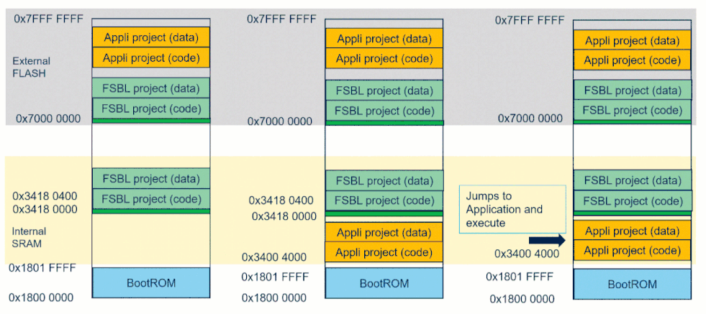
Model Deployment workflow
FSBL (First Stage Boot Loader)
As there is no internal flash, the configuration & initialization of the external memory are done here.
Application:
Model deployment & model inference programming are carried out here.
External Memory Loader:
The network data is stored here.

Slide 30
Project creation in Cube MX
Core System Setup
Enabling DCACHE, ICACHE & CACHEAXI
Enabled overdrive
Connectivity
Configures XSPI as OctoSPI to store FSBL, Application & model weights.
LPUART1 to print the debug data through Virtual Com Port.
Middleware Integration
Enabling EXT Mem Manager to map and manage external flash during boot.
Enabling EXT Mem loader to allow CubeProgrammer to write binaries in EXT Flash.
The AI model is imported in the X-CUBE-AI instance.

Slide 31
Project creation in Cube MX
X-CUBE-AI
Converts the ONNX model in the network.c file
Generates x-cube-ai.c file where MX CUBE AI Process() is defined and which manges the inference loop.
The generated output is then monitored using UART supported terminal.
As there is no internal flash the model inference is not possible in dev Boot mode.
So the Trusted.bin of the Application, FSBL & network data is written in the EXT flash using CubeProgrammer.

Slide 32
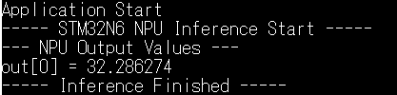
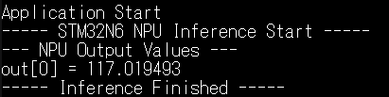
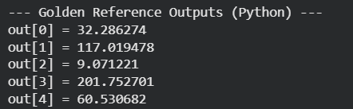
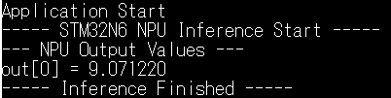
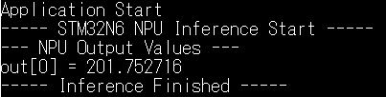
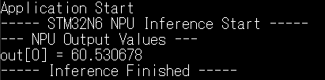
Results
Generated by inferring a numerical model
Python inference

Slide 33
Conclusion
Successfully designed a hardware–software co-design system for monocular depth estimation and path planning
Implemented a custom FPGA-based 8×8 convolution accelerator with ultra-low resource usage (<1% LUTs)
Achieved near bit-accurate matching with Python reference (0.00213% mismatch)
Developed a 7-state path-planning FSM with accurate yaw computation (<0.05% error)
Validated system performance through simulation and power analysis
Workflow on STM32N6 was explored and understood, demonstrating feasibility for MCU-based deployment
Demonstrates the practicality of real-time embedded vision for small UAVs and autonomous robots

Slide 34
Future Scope
Full deployment of the depth-estimation pipeline on STM32N6 NPU with optimized memory usage
Integration of FPGA and MCU modules into a complete UAV hardware stack
Implementation of additional CNN layers (ReLU, Hard-Swish, DWConv) directly in hardware
Scaling the convolution accelerator to support larger feature maps and deeper networks
Exploration of low-power ASIC/SoC implementation for commercial deployment

Slide 35
THANK YOU! Any Questions?

